Slide 1
ADIDAS Sales Analyis
Presented by Team 5:
Vineeth Reddy Kareddy
Moulika Sriramula
Narendra Bommisetty
Srikanth Reddy Narra

Slide 2
Agenda
Business Idea
About Data
Analysis
Conclusion

Slide 3
Business Idea
Our potential business idea is to focus on product and sales method optimization and future inventory management.
By identifying the most profitable products and sales methods, businesses can optimize their product mix and sales strategies to improve their overall profitability.
Based on the profitability of products and sales methods, businesses can make informed decisions about future inventory.
Stocking inventory based on the products and sales methods that have proven to be most profitable, businesses can optimize their inventory mix and reduce the risk of overstocking or understocking certain items.

Slide 4
About Data
Dataset from Data.world website
Objective : Analyze Adidas Sales Database
Company Industry : Design Company
Dataset Link : https://data.world/stellabigail/adidas-us-sales-datasets

Slide 5
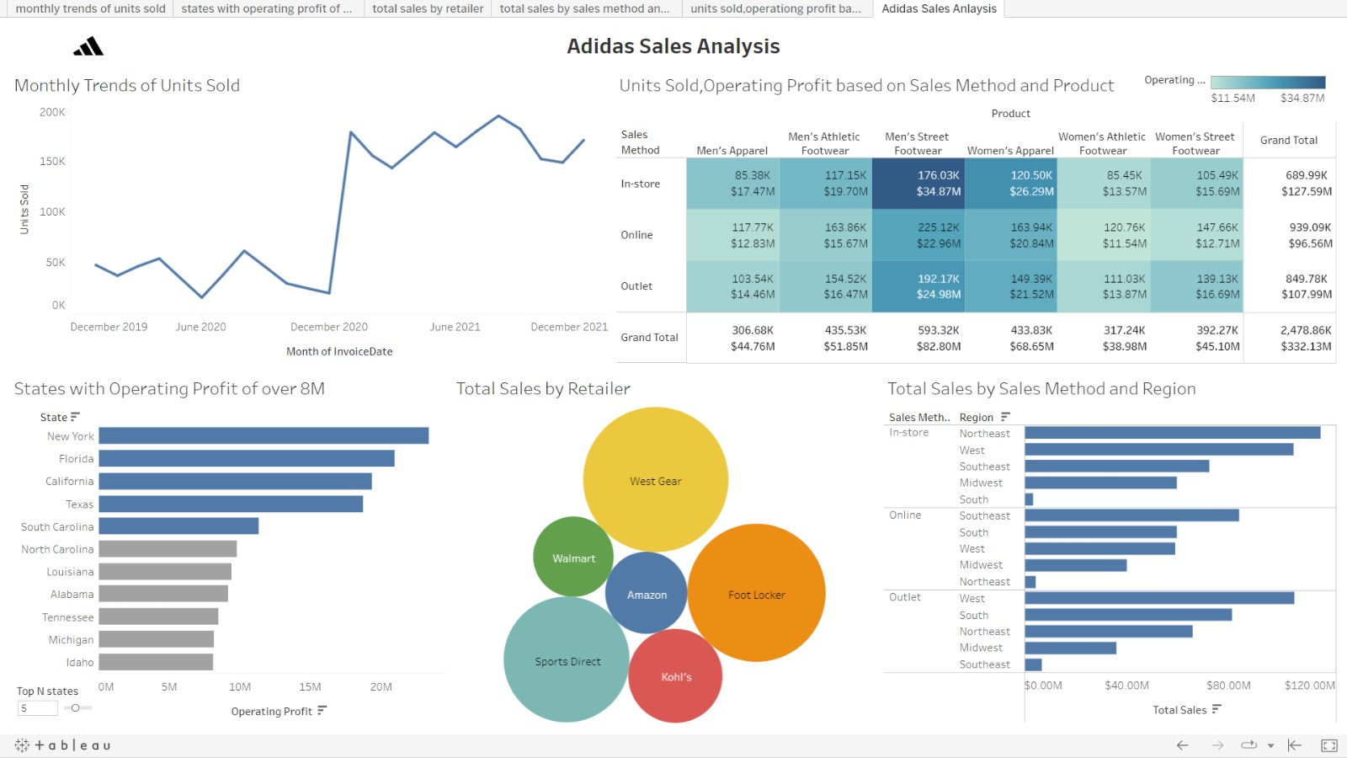
Dash Board

Slide 6
Conclusion
Mens street foot wear generated higher Operating profit throughout all the Sales methods. Baesd on this, Adidas stock more inventory in future for this product category to generate the profits.
They should also concentrate on increasing the Online sales of Womens athletic footwear when compared to other sales methods.
The inventory in all the regions should be managed based on popular Sales method and Product category in that Region.
By implementing above suggestions, business can not only improve their profitability but also enhance their ability to meet customer needs and stay competitive in the market.

Slide 7
THANK YOU

